Slide 1
Contemporary Moral Problems
M-F12:00-1:00SAV 264
Instructor: Benjamin Hole
Email: bvhole@uw.edu
Office Hours: everyday after class

Slide 2
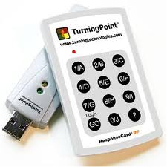
agenda
Clicker quiz
Conference
Presenters: Jose & Vanna

Slide 3
According to Jeremy Bentham, considerations of pain and pleasure determine:
what we ought to do.
what we will do.
both a and b.
neither a nor b.

Slide 4
What does Robert Nozick think we should conclude from his experience machine thought experiment?
Our experiences are not the only things that have value for us.
Pleasure and pain are the only things that are valuable for their own sakes.
Technological progress can have disastrous consequences.
We could be stuck in the Matrix.
Serving other people is more important than seeking our own pleasure.

Slide 5
Peter Singer claims that his principle (of utility):
takes no account of proximity or distance.
makes no distinctions based on how many people could help.
both a and b.
neither a nor b.

